Slide 1
Behavioral Genetic Data Analysis Co-twin control models
August 18th and 19th, 2021
Lecturers: Dr. Bastian Mönkediek¹, Mirko Ruks¹, Christoph Klatzka² ¹ Bielefeld University, Bielefeld, Germany ² Saarland University, Saarbruecken, Germany

Slide 2
Content
Omitted variable bias
Monozygotic and dizygotic twin pairs
Estimating within-pair effects
Differentiating genetic and environmental confounds
Conclusions
Further readings

Slide 3
Omitted variable bias: The problem
The starting point:
We want to know the effect of cognitive skills (X) on math grades (Y).
Our sample linear regression could be:
$$Y=b_{0}+b_{1}X+e$$
What means the „e“?
It represents – among other things – unobserved factors other than X that affect Y
Notes:
No contradiction with common non-shared environmental factors
Common with respect to the variables
Shared with respect to the two twins

Slide 4
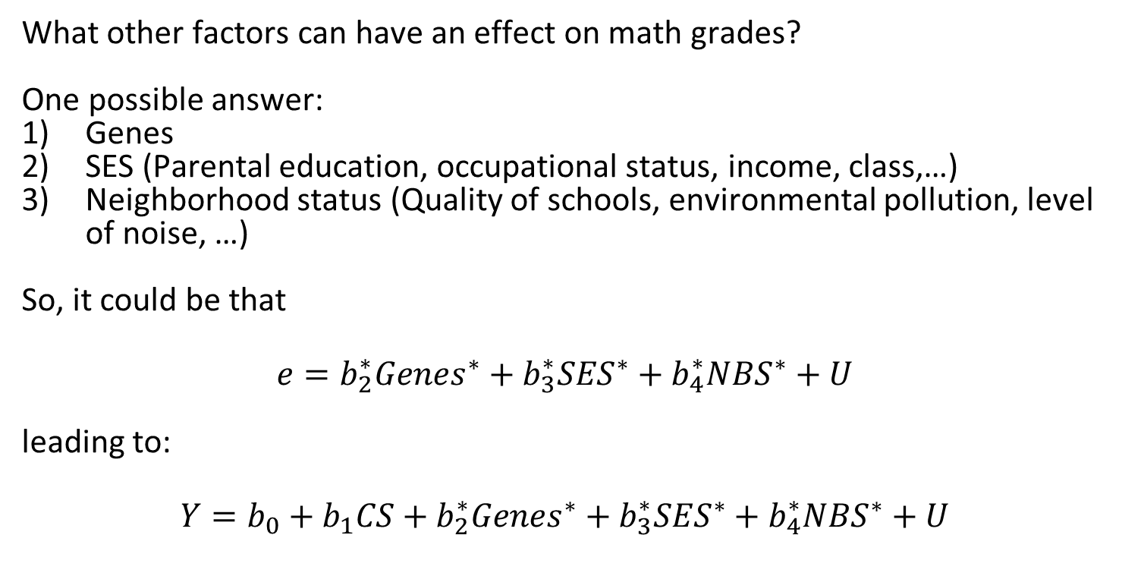
1. Omitted variable bias: The problem
What other factors can have an effect on math grades?
One possible answer:
Genes
SES (Parental education, occupational status, income, class,…)
Neighborhood status (Quality of schools, environmental pollution, level of noise, …)
So, it could be that
$$e=b_{2}^{∗}{Genes}^{∗}+b_{3}^{∗}{SES}^{∗}+b_{4}^{∗}{NBS}^{∗}+U$$
leading to:
$$Y=b_{0}+b_{1}CS+b_{2}^{∗}{Genes}^{∗}+b_{3}^{∗}{SES}^{∗}+b_{4}^{∗}{NBS}^{∗}+U$$
Notes:
No contradiction with common non-shared environmental factors
Common with respect to the variables
Shared with respect to the two twins

Slide 5
Omitted variable bias: The problem
Fine. So, what is the problem?
The omitted variable bias:
If the error term (i.e. in our case: Genes, SES, neighborhood status) correlates with our predictor cognitive ability, our estimate of the effect of cognitive ability on math grades is probably biased
Notes:
No contradiction with common non-shared environmental factors
Common with respect to the variables
Shared with respect to the two twins

Slide 6
1. Omitted variable bias: The problem
$$Cognitive Skills$$
$$Math grades$$
$$U$$

Slide 7
1. Omitted variable bias: The problem
$${Genes}^{∗}$$
$${SES}^{∗}$$
$${Neighborhood}^{∗}$$
$$Cognitive Skills$$
$$Math grades$$
$$U$$

Slide 8
1. Omitted variable bias: The problem
$${Genes}^{∗}$$
$${SES}^{∗}$$
$${Neighborhood}^{∗}$$
$$Cognitive Skills$$
$$Math grades$$
$$U_{2}$$
$$U_{1}$$

Slide 9
Omitted variable bias: Solutions
For twin data, we can distinguish two groups of confounders:
Genetic confounders (A)
Environmental confounders on the family level (C)

Slide 10
1. Omitted variable bias: The problem
$$A$$
$$C$$
$$Cognitive Skills$$
$$Math grades$$
$$U_{2}$$
$$U_{1}$$
If the red paths are not = 0 → the effect of cognitive skills on math grades probably will be biased!

Slide 11
Omitted variable bias: Solutions
Possible solutions:
Add all necessary control variables
Difficult and often impossible
Control by design
Different approaches exist (e.g., panel regression or co-twin control design)

Slide 12
2. Monozygotic and dizygotic twin pairs
In a data set with twins clustered in pairs, we can distinguish between-twin-pair and within-twin-pair variance.
Two types of twins:
Monozygotic twins (MZ) that share 100% of their genes
Between-pair-variance due to genetic and shared-environmental factors
Within-pair-variance due to non-shared environmental factors
Dizygotic twins (DZ) that share on average 50% of their genes
Between-pair-variance due to genetic and shared-environmental factors
Within-pair-variance due to genetic and non-shared environmental factors

Slide 13
2. Monozygotic and dizygotic twin pairs
Analyzing within-twin-pair differences of
MZ pairs controls for genetic and shared environmental confounding
DZ pairs controls for shared environmental and part of the genetic confounding
The only difference between MZ and DZ within-pair comparisons is the degree of genetic confounding.

Slide 14
3. Estimating within-pair effects
Two different approaches lead to the same result:
Fixed-effects models
Mixed-effects models

Slide 15
3. Estimating within-pair effects: The FE model
We start with a simple OLS with twin i clustered in pair j:
$$Y_{ij}=b_{0}+b_{1}X_{ij}+b_{2}Z_{j}+e_{ij}$$
We decompose the error term and get:
$$Y_{ij}=b_{0}+b_{1}X_{ij}+b_{2}Z_{j}+u_{j}+e_{ij}$$
$Y_{ij}$: Math degree
$X_{ij}$: Cognitive ability
$Z_{j}$: SES
$u_{j}$: error term on pair level
$e_{ij}$: error term on twin level

Slide 16
3. Estimating within-pair effects: The FE model
Now, we demean the variables (within-transformation or demeaning):
$${(Y}_{ij}−{\overline{Y}}_{ij})=b_{0}+b_{1}{(X}_{ij}−{\overline{X}}_{ij})+b_{2}{(Z}_{j}−{\overline{Z}}_{j})+{(u}_{j}−{\overline{u}}_{j})+{(e}_{ij}−{\overline{e}}_{ij})$$
Since $Z_{j}={\overline{Z}}_{j}$, so $Z_{j}−{\overline{Z}}_{j}=0$and $u_{j}={\overline{u}}_{j}$, so $u_{j}−{\overline{u}}_{j}=0$
we get:
${\ddot{Y}}_{ij}=b_{0}+b_{1}{\ddot{X}}_{ij}+{\ddot{e}}_{ij}$with $\ddot{var}$ denoting the demeaned variable
$b_{1}$ is an estimate of the within-pair effect of X on Y
Drawback: We cannot estimate effects of variables without within-pair variance

Slide 17
3. Estimating within-pair effects: The FE model
In R:
install.packages(„plm“) # install package
library(plm) # load package
model_fe <- plm(formula = math ~ IQ, # the model equation
data = df_final, # the data set
index = c("fid","ptyp"), # ID vars
model = "within") # within-estimator
summary(model_fe) # show model results

Slide 18
3. Estimating within-pair effects: The ME model
An alternative is to account for the clustering in the data via a mixed effects model.
We start again with the model of the decomposed error term:
$$Y_{ij}=b_{0}+b_{1}X_{ij}+b_{2}Z_{j}+u_{j}+e_{ij}$$
$Y_{ij}$: Math degree
$X_{ij}$: Cognitive ability
$Z_{j}$: SES
$u_{j}$: error term on pair level
$e_{ij}$: error term on twin level

Slide 19
3. Estimating within-pair effects: The ME model
Now, we demean the predictor of interest controlling for the twin pair mean:
$$Y_{ij}=b_{0}+b_{1}{(X}_{ij}−{\overline{X}}_{ij})+b_{2}Z_{j}+b_{3}{\overline{X}}_{ij}+u_{j}+e_{ij}$$
$b_{1}$: Within-pair effect of $X_{ij}$
$b_{3}$: Between-pair effect of $X_{ij}$

Slide 20
3. Estimating within-pair effects: The ME model
The intra-class correlation coefficient (ICC) tells us how much of the (residual) variance of $Y_{ij}$ is on the family level:
$${ICC}_{f}=\frac{var(u_{j})}{var\left(u_{j}\right)+{var(e}_{ij})}$$
E.g.: $ICC=0.3$ → 30% of the (residual) variance on the family level

Slide 21
3. Estimating within-pair effects: The ME model
In R:
install.packages(„lme4“) # install package for ME model
Install.packages(„performance“) # install package for ICC
library(lme4) # load package
library(performance) # load package
model_me <- lmer(formula = math ~ 1 + IQ_dev + IQ_m + (1|fid), # model equation
data = df_final) # data set
summary(model_me) # show model results
icc(model_me) # compute residual ICC

Slide 22
4. Differentiating genetic and environmental confounds
We already know: MZ twins share 100% of their genes. DZ twins share on average 50% of their genes.
For MZ twins there are only (non-shared) environmental confounds of the within-pair effect
For DZ twins there are both genetic and (non-shared) environmental confounds of the within-pair effect
Thus, the comparison of the within-pair effects differ between MZ and DZ pairs informs us about the degree of genetic confounding!

Slide 23
4. Differentiating genetic and environmental confounds
Let the within-effect vary by zygosity (0=MZ; 1=DZ)
Fixed-effects (we cannot estimate the main effect of zygosity):
$$Y_{ij}=b_{0}+b_{1}{\ddot{X}}_{ij}+b_{2}{\ddot{X}}_{ij}Zyg+u_{j}+e_{ij}$$
$$Y_{ij}=b_{0}+(b_{1}+b_{2}Zyg){\ddot{X}}_{ij}+u_{j}+e_{ij}$$
Mixed-effects:
$$Y_{ij}=b_{0}+b_{1}{\ddot{X}}_{ij}+b_{2}{\ddot{X}}_{ij}Zyg+b_{3}Z_{j}+b_{4}{\overline{X}}_{ij}+b_{5}{Zyg}_{j}+u_{j}+e_{ij}$$
$$Y_{ij}=b_{0}+(b_{1}+b_{2}Zyg){\ddot{X}}_{ij}+b_{3}Z_{j}+b_{4}{\overline{X}}_{ij}+b_{5}{Zyg}_{j}+u_{j}+e_{ij}$$
$b_{1}$: Within-pair effect for MZ pairs
$b_{2}$: Difference between MZ/DZ within-pair effects. A significant interaction term $b_{2}$ indicates genetic confounding!
$b_{5}$: Effect of zygosity (should not matter)
Alternative: Calculate separate models by zygosity. Several drawbacks: Reduced sample size, less power, …

Slide 24
5. Conclusion
Unobserved confounders may bias estimates in cross-sectional models
Comparing twins allows to control for genetic and shared environmental confounders
We can do that by estimating a FE or a ME model
A within-pair effect significantly varying by zygosity indicates genetic confounding

Slide 25
6. Further readings
Bell, A., Fairbrother, M., & Jones, K. (2019). Fixed and random effects models: making an informed choice. Quality & Quantity, 53, 1051–1074. https://doi.org/10.1007/s11135-018-0802-x
A very useful discussion of Random-effects and Fixed-effects models for clustered data, their assumptions and how they relate to each other. They show how to combine the advantages of both model strategies
Turkheimer, E., & Harden, K. (2014). Behavior Genetic Research Methods: Testing Quasi-Causal Hypotheses Using Multivariate Twin Data. In H. Reis & C. Judd (Eds.), Handbook of Research Methods in Social and Personality Psychology (pp. 159-187). Cambridge University Press. https://doi.org/10.1017/cbo9780511996481.012
Turkheimer and Harden first discuss how to use multilevel models for causal inference with twin data. In a second step, they relate this approach to the ACE approach more commonly applied in behavioral genetics.

